Slide 1
BANKRUPTCY BANKRUPTCY PREDICTION USING MACHINE LEARNING
FA-582: Group 1
Tashveen Kaur, Abhinav Ganguly, Clinton Nwokike

Slide 2

Agenda
Introduction
Problem Statement: Why Bankpurtcy?
Recent News Articles
Dataset Description
EDA – Summary Statistics
EDA – Data Visualization
EDA – Pre-processing
Algorithms Implemented
Random Forest
Logistic Regression
LDA
QDA
KNN
Results
Some Challenges

Slide 3

Introduction
The project aims to evaluate financial market data through data collection, data preparation, feature extraction, data cleaning, analytical processing, and algorithmic techniques.
We employed various models to predict bankruptcies and attempted to select the best model feasible by analyzing the data and utilizing various machine learning methods.

Slide 4

WHY BANKRUPTCY?
One of the primary objectives of credit risk assessment is predicting business insolvency.
Bankruptcy or corporate failure can hurt both the individual company and the global economy.
Particularly since the financial crisis of 2007–2008, it has elevated in importance for most financial institutions, professionals, and scholars.
Rising interest rates and inflation have created more probability of bankruptcy in banks and institutions.
Research Question:
Can we accurately predict bankruptcy using Machine
Learning Models?

Slide 5

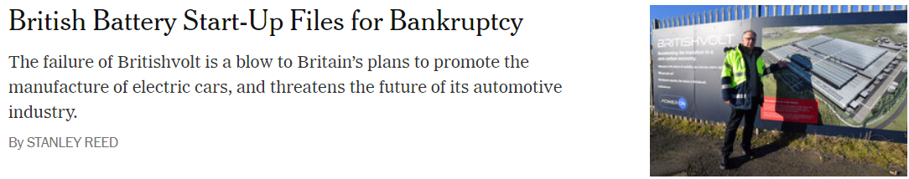
RECENT NEWS ARTICLES

Slide 6
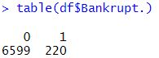
Dataset
Description of the data
The data set we have chosen was collected from the Taiwan Economic Journal from 1999 to 2009. The data contains Bankrupt companies that were identified based on the business regulations of the Taiwan Stock Exchange.
Features of the data
Target variable: Bankrupt (0 or 1)
How many 0 and how many 1?
Data contains different industries Manufacturing, Shipping, retail, Tourism, Pharmaceuticals
Number of years of data 10 years (From 1999 to 2009)
Some of the features from our Dataset:
Operating Gross Margin | Quick Ratio
Net Value Per Share | Cash Flow Rate

Slide 7
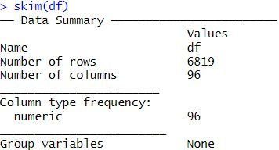
Exploratory Data Analysis: Summary Statistics
Zero Missing Values
Data type for all features are numeric
The Bankrupt Variable was changed into Factor using as.factor()
96 Features
6819 Observations
Mean range between -----------
Standard Deviation range between ------

Slide 8
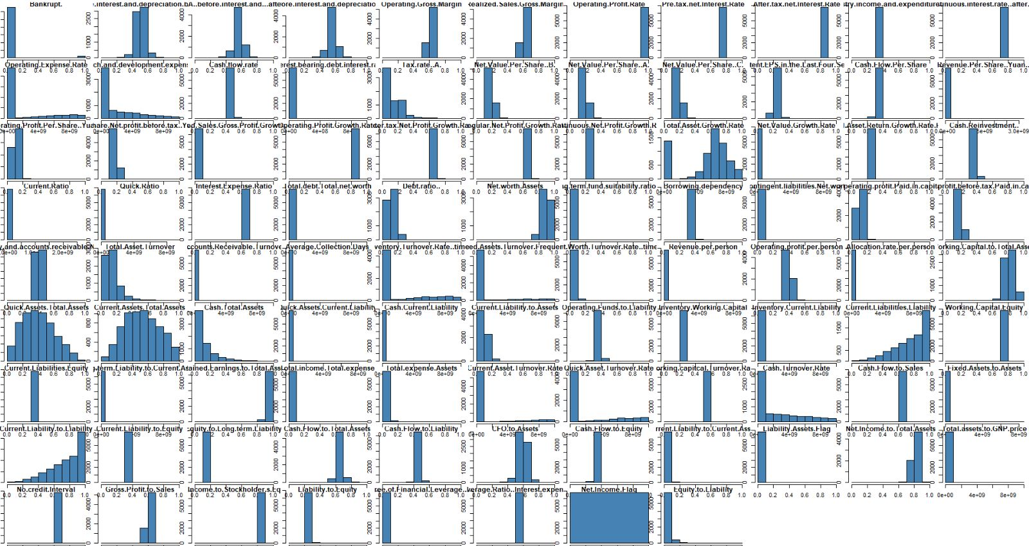
Exploratory Data Analysis: Data Visualization
Visualized all the features in our dataset to understand the skewness of our Dataset.
Performed Shapiro Wilk test and Anderson Darling test for normality on our dataset

Slide 9
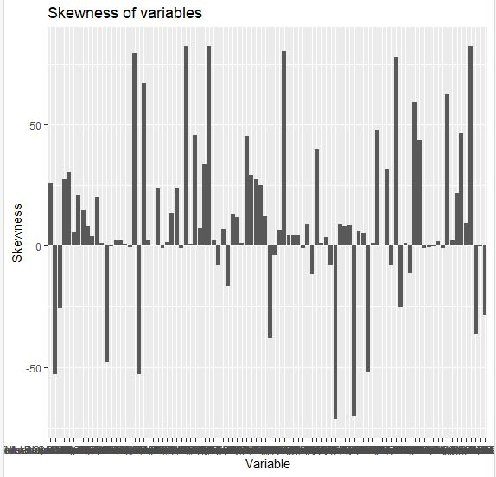
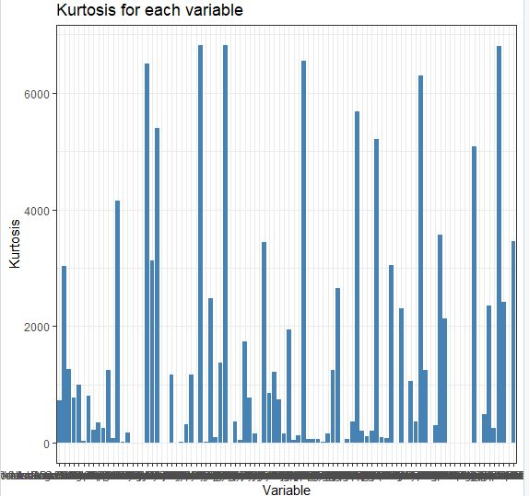
Exploratory Data Analysis: pre-processing
Finding missing values in our dataset
Dropping the Net.Income.Flag column from our dataset (only one unique column)
Normalizing the dataset for skewness and Kurtosis

Slide 10
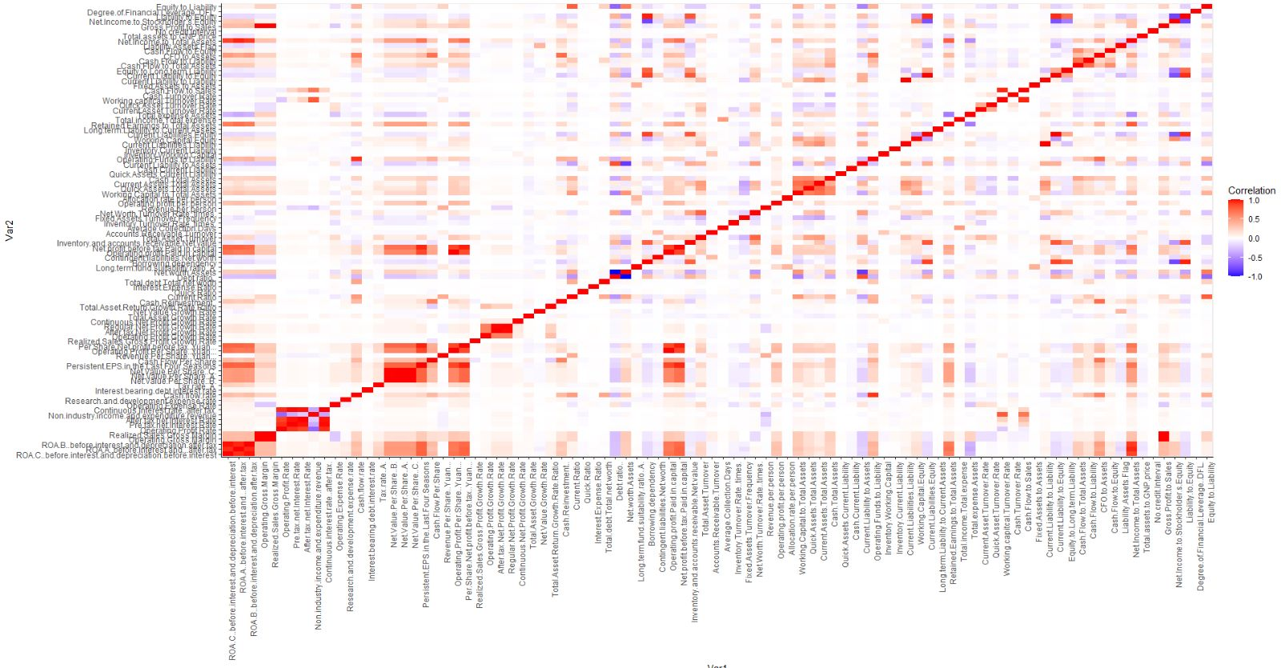
Exploratory Data Analysis: Data Visualization
Creating a heatmap of correlation of all the features in our dataset.
The data seems to be extremely cluttered.
Difficulty in visualizing this correlation heatmap
So What Do We Do Now?

Slide 11

Machine Learning Algorithms Used:
Logistic Regression
Random Forest
Linear Discriminant Analysis (LDA)
Quadratic Discriminant Analysis (QDA)
K-Nearest Neighbors

Slide 12
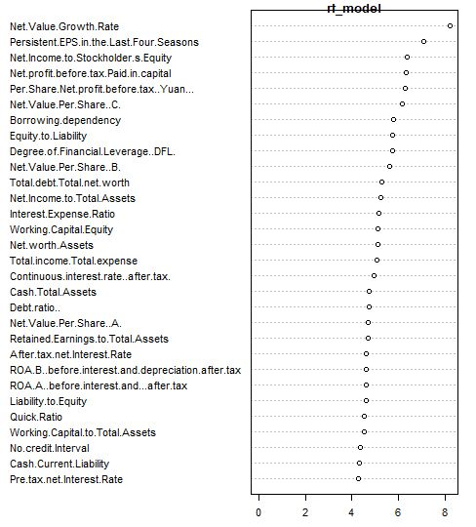
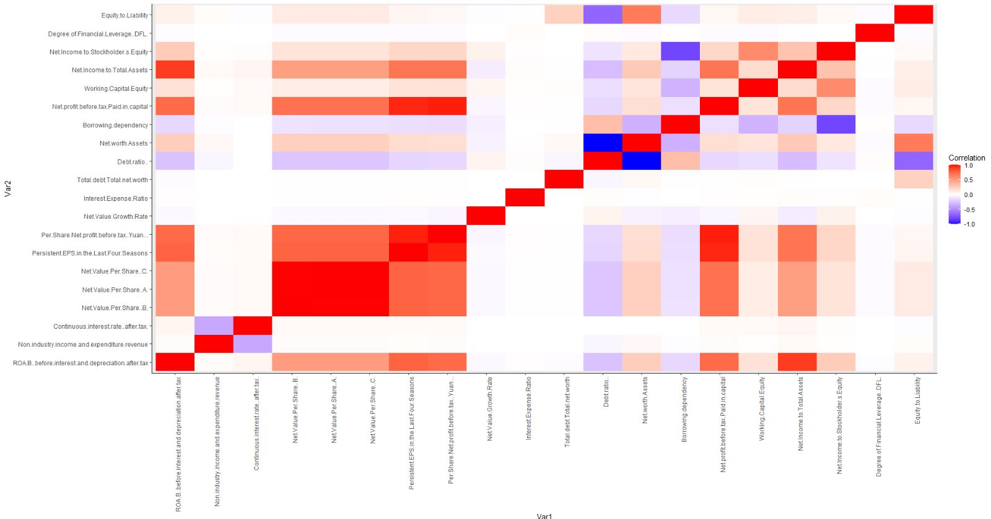
Random Forest
Implementing a Random Forest model to list out the 20 most important features from our dataset
From the given correlation heatmap, we can infer that the following attributes are highly correlated:
Per Share Net Profit Before Tax
EPS in the Last 4 seasons
Net Value per Share A
Net Value per Share B
Net Value per Share C

Slide 13
Methodology: Random Forest
rf model Divided the data set into training and testing sets
set the seed
Created the random forest model
Predicted the target variables
Extracted most important features using importance function
Sorted the important features in decreasing order
Created a list of top 15 important functions that we will use in our Machine Learning Models

Slide 14
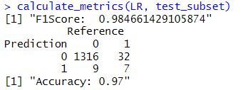
Logistic Regression
Used the top 15 important variables in LR model
from random forest created a subset of the bankrupt variable with the above 15 features created a logistic regression model
Logistic regression is particularly useful for bankruptcy prediction because it can handle non-linear relationships between the predictors and the dependent variable. It is also robust to outliers and can handle missing data, which are common issues in financial data.

Slide 15
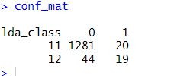
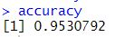
Linear Discriminant Analysis (LDA)
Utilized the most correlated variables to create the LDA model.
To calculate the heatmap, we removed variables with near-zero variance.
Calculated the correlation matrix.
Installed the reshaped library.
Melted the correlation matrix.
Plotted the heatmap
Found the highly correlated variables
Created a subset of highly correlated variables
Created the LDA model with these variables Computed the confusion matrix, f1 score and accuracy
LDA is effective for bankruptcy prediction as it helps to identify key variables that differentiate between bankrupt and non-bankrupt companies, enabling a better understanding of factors contributing to financial distress and the development of more accurate prediction models.

Slide 16
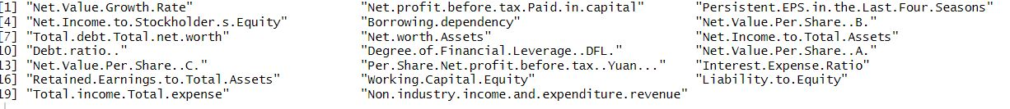
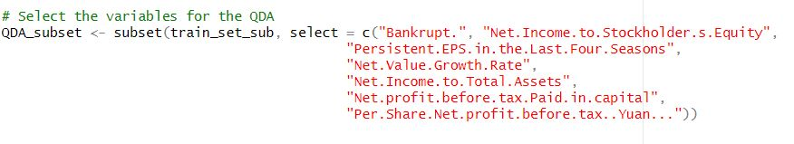
Quadratic Discriminant Analysis (QDA)
Before Pre-processing
After Pre-processing
What next?

Slide 17
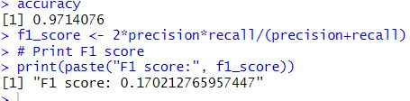
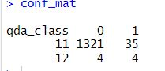
Quadratic Discriminant Analysis (QDA)
Methodology
Extract the top 20 features list from the sorted features importance from the random forest model
We formulated a heatmap from these 20 features and then extracted 6 features that were highly correlated, and omitted them due to muti-collinearity
Created a subset of these 6 important variables and formulated a QDA model
Extracted predictions and confusion matrix
Calculated accuracy and f1 score
QDA is preferred in bankruptcy prediction due to its ability to handle non-linear relationships between variables and to estimate class probabilities, providing a useful tool for risk assessment in financial data analysis.

Slide 18
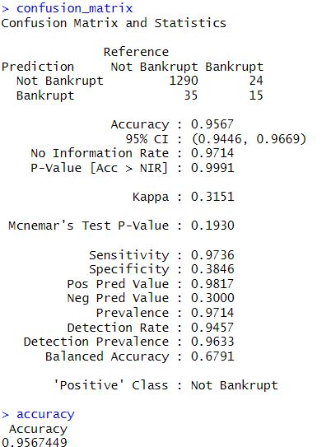
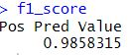
K – Nearest Neighbors: KNN = 2
Utilized the same 6 features for the KNN model
Extracted predictions and confusion matrix
Calculated accuracy and f1 score
Tried using different values of K and checked the accuracy which was almost the same for every k value
KNN can be useful in bankruptcy prediction because it does not assume any underlying distribution of the data, which is especially important when dealing with financial data that may not follow a normal distribution

Slide 19
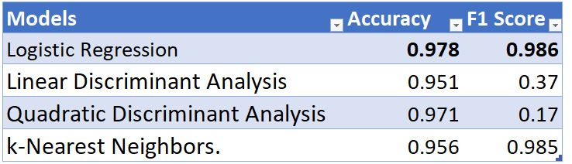
Results
As the dataset was clean, we were able to retain maximum information and maintain a great accuracy score.
As a result, we recommend Logistic Regression as the best Machine Learning model to predict bankruptcy

Slide 20

Some Challenges:
Some important challenges to our project were feature selection, dimension reduction, data preprocessing, and model selection
Possibility of correlation between various dimensions
In-depth homogenization would occur for some features with higher correlation, making it really difficult to conduct a thorough analysis of the data and creating a challenge to defining features
as the dimension increases, the possible combinations of clusters grow, and the clustering will be hard to define

Slide 21
THANK YOU
Stevens Institute of Technology
1 Castle Point Terrace, Hoboken, NJ 07030

